Slide 1

LIBRARY DATABASE
ANALYSIS

Slide 2

LIBRARY DATABASE ANALYSIS

Slide 3
PROBLEM STATEMENT
Libraries face challenges in managing collections and monitoring borrower activity due to manual systems or outdated software, leading to issues like misplaced books and sluggish searches.
A comprehensive digital library database management system is needed to streamline cataloging, automate transactions, and offer insightful data analysis. This would improve resource utilization and user experience.

Slide 4
INTRODUCTION
A library database management system is designed to streamline and automate the intricate operations of contemporary libraries.
By organizing, storing, and managing information pertaining to books, borrowers, library branches, and transactions in a structured and efficient manner, this system guarantees reliable cataloging, expedited book searches, automated lending processes, and effective resource tracking.

Slide 5
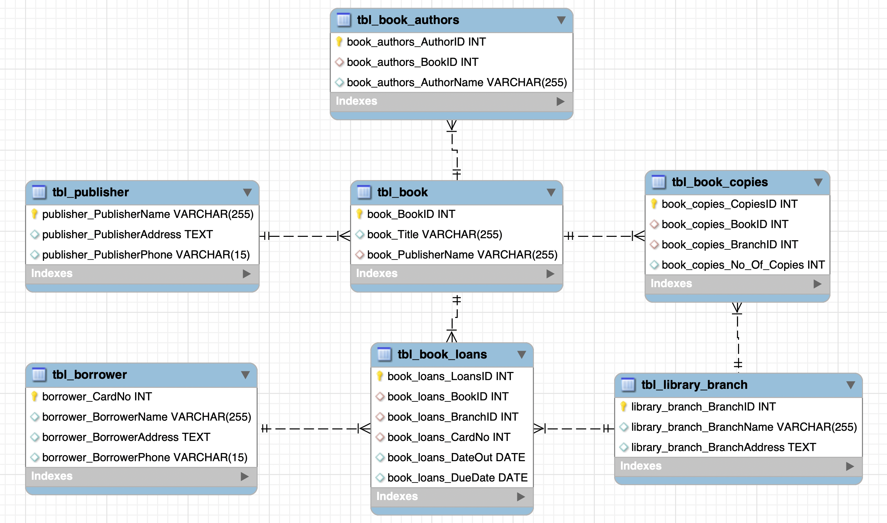
ER DIAGRAM

Slide 6
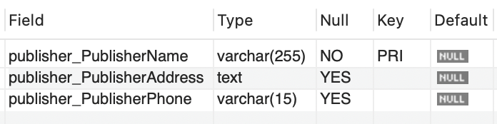
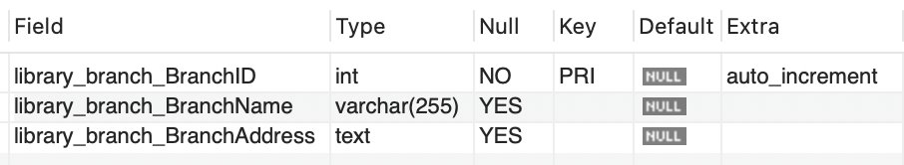
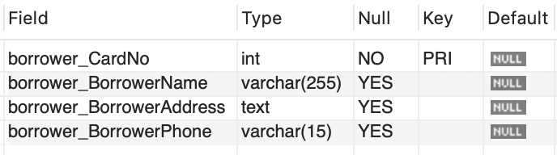
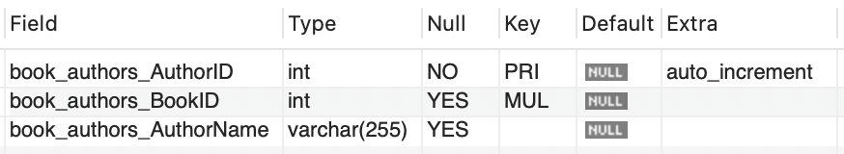
TABLES
Publisher Table
Library Branch Table
Authors Table
Borrower Table

Slide 7
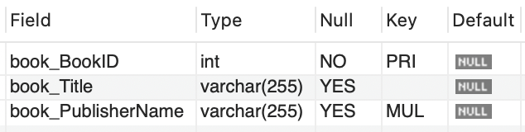
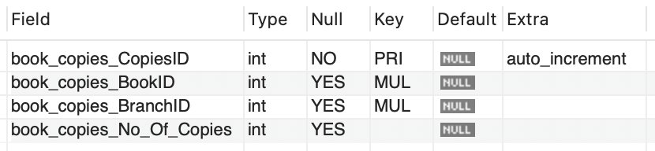
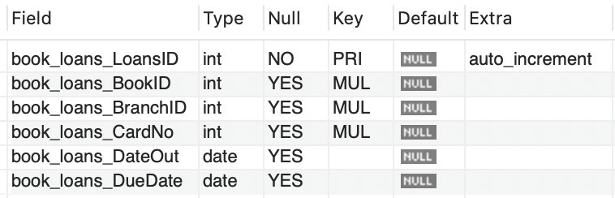
TABLES
Books Table
Book Copies Table
Book Loans Table

Slide 8
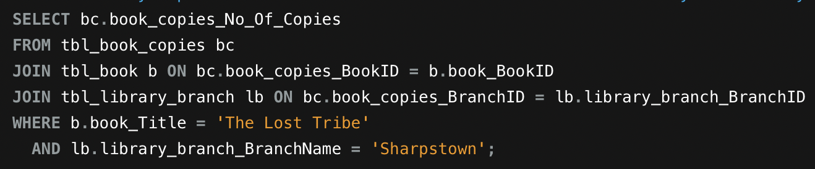
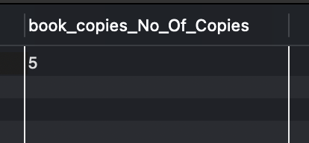
How many copies of the book titled "The Lost Tribe" are owned by the library branch whose name is "Sharpstown"?

Slide 9
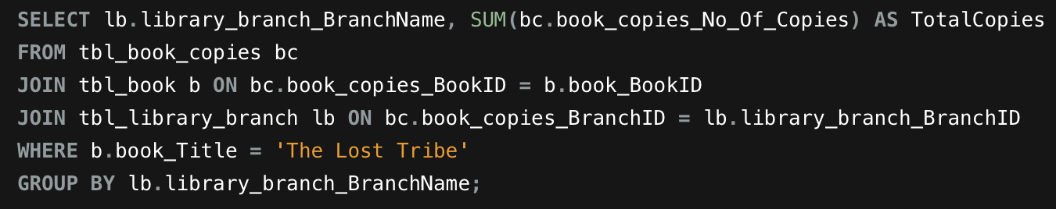
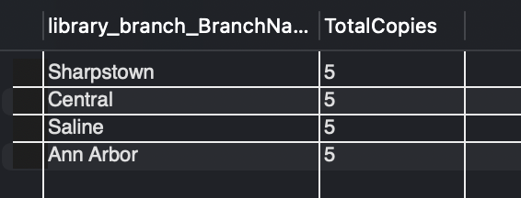
2. How many copies of the book titled "The Lost Tribe" are owned by each library branch?

Slide 10
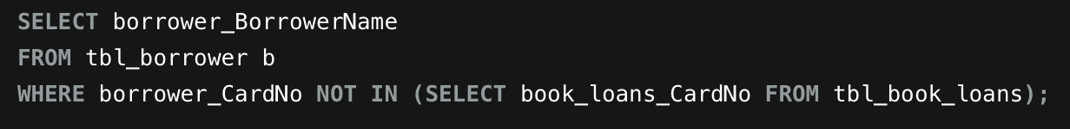
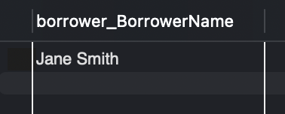
3. Retrieve the names of all borrowers who do not have any books checked out.

Slide 11
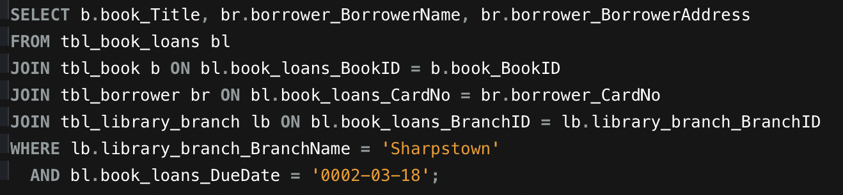
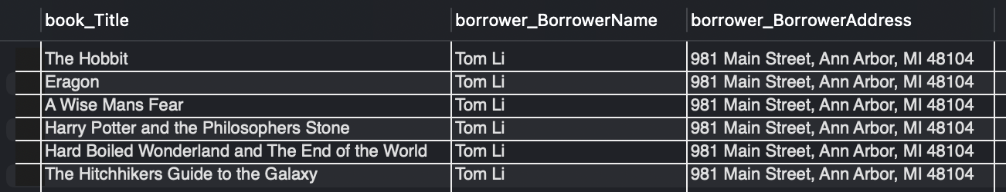
4. For each book that is loaned out from the "Sharpstown" branch and whose Due Date is 2/3/18, retrieve the book title, the borrower's name, and the borrower's address.

Slide 12
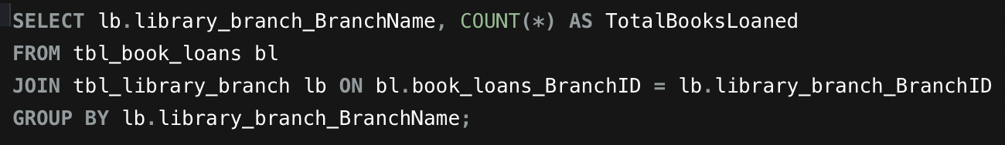
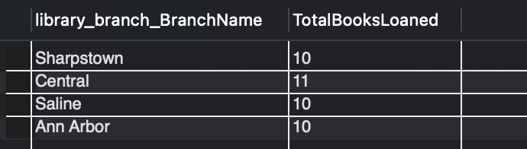
5. For each library branch, retrieve the branch name and the total number of books loaned out from that branch.

Slide 13
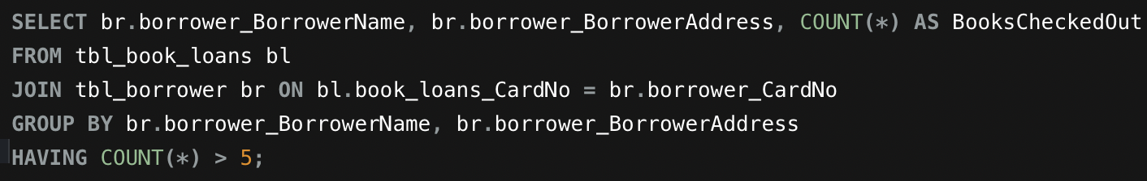
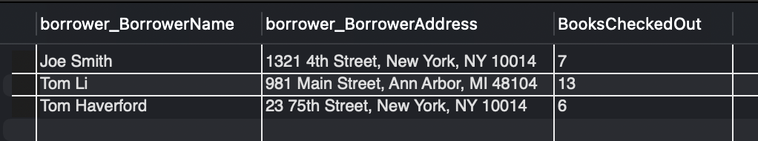
6. Retrieve the names, addresses, and number of books checked out for all borrowers who have more than five books checked out.

Slide 14
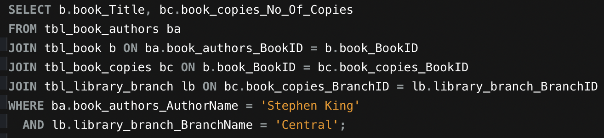

7. For each book authored by "Stephen King", retrieve the title and the number of copies owned by the library branch whose name is "Central".

Slide 15
KEY FINDINGS
Key Finding | Description
Most Prolific Author | J.K. Rowling holds the highest number of book entries in the collection.
Total Book Copies | 400 copies are distributed across all library branches.
Top Borrowers | Tom Li, Angela Thompson, and Michael Horford are the most active borrowers.
Branch with Largest Inventory | Sharpstown branch holds the largest inventory with 100 copies.
Unique Titles | The library database contains 20 unique book titles.
Borrowing Behavior | Most borrowers check out a diverse range of over 7 books on average.
Circulation Status | All book titles are currently loaned out; none remain unloaned.
Overdue Books Monitoring | Detailed records highlight borrowers with overdue books, underscoring the need for follow-up.
Publisher Contribution | Bloomsbury and DAW Books are major contributors to the library’s inventory.

Slide 16
RECOMMENDATIONS
Recommendation | Description
Automated Overdue Alerts | Set up automated reminders for borrowers to return books on time and reduce overdue circulation.
Optimize Inventory Distribution | Redistribute book copies among branches to balance demand and increase resource accessibility.
Expand and Diversify Collection | Acquire more titles from popular authors and diverse genres to cater to varied reader interests.
Enhance Borrower Engagement | Offer personalized recommendations and loyalty programs for frequent borrowers to boost usage.
Strengthen Data Management | Perform regular data audits and cleansing to maintain accuracy and integrity.

Slide 17

THANK YOU
GROUP MEMBERS :-
GANGA PRATHYUSHA SAMIREDDY
KRISHNA VENKATA RAO MUMMIDI

